Slide 1
Camera Geometry

Slide 2
Image formation in optical camera
P → p : Projection
Center of projection
P
O
p
Projection plane

Slide 3
Camera Geometry
Camera geometry models 3D to 2D.
It describes the relationship between scene and image.
Uses mathematical principles and models.
Defines how 3D points project to 2D.
Important in various vision tasks.

Slide 4
Basic Concepts
Image Plane:
The 2D surface on which the 3D scene is projected.
Camera Coordinates (World Coordinates):
The 3D world coordinates (X,Y,Z) are projected onto the image plane to give 2D coordinates (x,y).
Projection Model:
The simplest model for camera geometry is the pinhole camera model
approximates how light rays from the 3D scene pass through a small hole (the pinhole) and project onto the image plane.

Slide 5
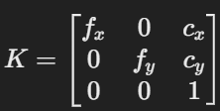
Intrinsic Parameters
internal characteristics of the camera, including focal length, optical center, and distortion parameters.
represented as a camera matrix.
fx​, fy​: Focal lengths (in pixels) along the x and y axes.
cx​,cy​: Optical center (usually the center of the image).

Slide 6
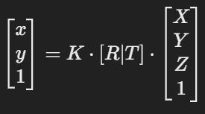
Extrinsic Parameters
Describe the position and orientation of the camera in the 3D world
Represented as a rotation matrix R and a translation vector T.
The relationship between 3D world coordinates X and 2D image coordinates x is given by the equation:
[R∣T] is the camera's extrinsic matrix combining rotation and translation.

Slide 7
Intrinsic vs Extrinsic Parameters
Intrinsic parameters define how the camera captures the scene in 2D space.
Extrinsic parameters describe the camera's position and orientation in the 3D world.
Together, they allow accurate 3D to 2D projections and are essential for tasks like camera calibration, 3D reconstruction, and motion tracking.

Slide 8
Applications of Camera Geometry
Camera Calibration
Stereo Vision
3D Reconstruction
Motion Estimation

Slide 9
Projection
Process of mapping 3D objects onto a 2D plane.
Two types of projection:
Perspective Projection
Parallel Projection

Slide 10

Perspective Projection
Objects appear smaller as they move farther from the camera.
Parallel lines converge at a vanishing point.
Based on projective geometry, commonly used in computer vision, 3D rendering, and photography.
For a 3D point P(X,Y,Z), the projected 2D coordinates (x,y) on the image plane are:

Slide 11
Parallel Projection
Objects do not shrink with distance.
Parallel lines remain parallel in the projection.
Used in technical drawings, CAD, and engineering blueprints.

Slide 12
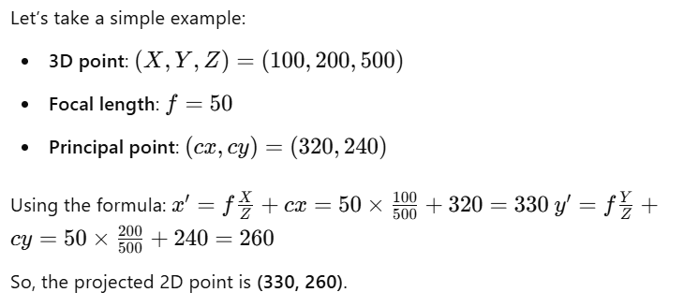
Numerical

Slide 13
Pinhole camera Model
simple and fundamental model.
image formation using a small hole instead of a lens.
It consists of:
A lightproof box (to block unwanted light)
A tiny pinhole (acting as an aperture)
A screen or film (to capture the inverted image)

Slide 14
Working of Pinhole Camera
Light rays from an object pass through the pinhole.
These rays travel in straight lines and form an inverted image on the opposite side of the box.
The smaller the pinhole, the sharper the image (but dimmer); a larger pinhole makes the image brighter but blurry.

Slide 15
Pinhole Characteristics
No lens required.
Infinite depth of field (everything is in focus).
Image is inverted due to the straight-line nature of light.
Works best in bright lighting conditions.

Slide 16

Camera with Lenses
Uses optical elements to focus light efficiently
Improving image quality, brightness, and sharpness
A camera with lenses typically consists of:
Lens: A curved glass element that refracts and focuses light.
Aperture: Controls the amount of light entering the camera.
Image Sensor/Film: Captures the focused image.
Focal Plane: The plane where light converges to form a sharp image.
A lens follows the thin lens equation:
Magnification: d_{i}/d₀

Slide 17
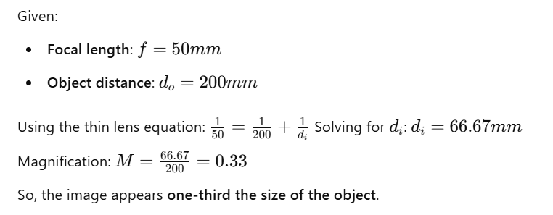
Numerical Example

Slide 18
Charge-Coupled Device(CCD) Cameras
high-quality image sensors.
consists of a grid of photosensitive pixels that collect light and convert it into electrical charge.
used in scientific, industrial, and professional imaging applications.
convert light into electrical signals with high sensitivity, low noise, and excellent image quality.

Slide 19
How CCD Cameras Work
Photon Collection – Light enters the camera and strikes the CCD sensor.
Charge Accumulation – Each pixel stores a charge proportional to the light intensity.
Charge Transfer – Charges are shifted across the sensor in a controlled manner.
Readout & Conversion – The accumulated charge is converted into a voltage, amplified, and digitized.
Image Formation – The digitized signals are processed to create an image.

Slide 20
Types of CCD Sensors
Full-Frame CCD:
Entire sensor area is exposed to light.
Requires a mechanical shutter.
Frame-Transfer CCD
Uses a separate storage area to quickly transfer charges.
Reduces image lag and improves speed.
Interline-Transfer CCD
Pixels have light-blocking structures (microlenses) to transfer charge instantly.
Common in video cameras and surveillance.

Slide 21
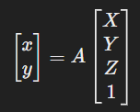

Affine Cameras
simplifies the general perspective projection.
parallel lines remain parallel in the image.
A 3D object does not shrink with increasing depth.

Slide 22
Thanks

